Slide 1
Webmethods Integration platform
Narayan Bethmangalkar
Harish Krishnaswamy
Biswa Bhushan Dalai
Satish Shankar
Jaideep Pegu
Sreekanth Siddapur
May 2017

Slide 2
agenda
Overview of the Integration Platform
Deep Dive
Designer Service Development
webMethods Integration Server
webMethods Adapters
Demo

Slide 3































Digital Business Platform
Capability Map
BUSINESS & IT TRANSFORMATION
ANALYTICS & DECISIONS
Machine
Learning
Predictive
analytics
Alerts &
Actions
Process
Analytics
Business strategy & planning
Visual analytics
Streaming analytics
Pattern
matching
Event
processing
Event routing & persistence
Customer
journey mapping
PROCESS
Dynamic
orchestration
Process
automation
Case
management
Process
monitoring
Design &
analysis
Application
development
Mobile
enablement
Task & work
management
Rules
management
Content
management
Risk & Compliance
management
INTEGRATION
Application
integration
B2B
integration
Master data
management
Cloud
integration
Portfolio
management
API
management
Big Data
integration
IoT
integration
Services
management
Managed file transfer
Enterprise
architecture
IN-MEMORY
DATA
In-Memory data
management
Messaging
Distributed
cache
Search &
Compute

Slide 4

















Spaghetti Architecture
$
Security
Integration
perf/scale
standards
web services
Rest
Microservices
TASKS
DECISIONS
DATA
INTEGRATION
Notes:
Here is the current state of the IT architecture within a large organization.
Customers have invested in large ERP and CRM applications like SAP to run their business. These packaged applications offer standardized processes and dominate the IT landscape of these customers. A lot of data flows in and out of these applications and this data needs to be synchronized and shared with other applications. The quickest way to share data has been to integrate directly between the two applications but over time these one-off integrations have created point to point spaghettis. Adding to this IT landscape are more applications that organizations have inherited via M&A activities but these also have to be integrated which makes the point to point mess even worse. Externally customers communicate with B2B partners via gateways and exchange data that needs to find their way to the internal applications as well. Some customers have tactically addressed the point to point integration issue by adding DSBs (department service bus) and investing in MDM (master data management) for single view initiatives but this only added to the complexity of the landscape. Customers have also built employee and customer portals to expose data externally but this adds more integration points with internal applications to get access to this data.
So what is a CIO to do – she not only has to deal with the cost associated with this complexity but is under pressure from the business who wants IT to provide a competitive edge. With the emergence of the cloud, an easy answer was to start moving on-premise applications to the cloud and save costs. Giant ERPs like SAP got carved out and modules like CRM and HR moved to the cloud to benefit from this new model. However, doing so made the integration mess even worse since integrations now spanned outside the organizational boundaries out to the public cloud. Meanwhile, emerging mobility and BYOD initiatives required that employees, customers and partners now have access to data from their mobile devices but this required making this access available from the internal applications where this data resides, which added to the proliferation of data. Another area for cost reduction was migrating data warehouses and BI applications for understanding buyer behavior to Hadoop but analytics continues to be reactive (using data at rest) rather than real-time at the right time (using data in motion), not to mention more data siloes to now manage. Finally, IoT data from sensors and devices have added new interaction patterns but also created an explosion of data – this is Big Data but how do you tie this all in to make the right decisions and get the desired outcome?
We know that ERP applications are standardized and harmonized and are great for running a business but its just table stakes - offers no differentiation. Custom applications is what allows an organization with its unique business logic to differentiate and compete in the marketplace and in today’s customer centric world you need mobile apps to better engage with your customers. Now, lets take a look at what’s in an application – you have presentation logic that is exposed to the end user, business logic that is the heart of the application and an underlying database to store the data. Where is this data coming from, you guessed it – from the internal applications. Now, IT departments have been building custom apps for a long time but traditionally it has required a lot of coding and IT departments have had to address topics like security, authentication, authorization, performance and scalability over and over again leading to application siloes. Another challenge has been the continued evolution of standards – first there was SOAP which was deemed to heavy, then REST which was more mobile and API friendly and now the buzz is all about microservices. This has led to new versions of apps being built just to support new standards and invocation styles without any reuse. Over time, they create parallel sets of applications and in many cases build the same things over and over again as there is no easy way to reuse the business logic that was built before. So what exactly is in this business logic - there is integration logic, data logic, decision logic and task/process logic, these are the building blocks for constructing reusable applications.
Now back to our CIO, in addition to the business pressures facing them they are also being challenged to reduce costs, reduce complexity but increase the pace of innovation since that is key for the business. According to a 2015 Gartner study CIOs spend 79% of their money just trying to keep the lights on which leaves just 21% of the budget to innovate. In fact, every time the CIO adds another component to her already complicated architecture it puts additional pressure on the 21%. While we have talked a lot about how IT architectures have become a bit of a mess, we are not trying to point fingers at anyone. We have seen this in virtually every large company we have visited – it is the natural evolution of architecture that needs to be updated in order to meet changing business needs. However, CIOs need to find a better way to innovate on top of what they have already invested to increase innovation while helping to simplify the complicated architectures they have.
Let’s talk about Software AG’s 21st Century application architecture – the Digital Business Platform.
We have an ‘enterprise’ ESB which was initially used to solve the point to point integration problem by using pub/sub and allowing integrations to be one to many. However, the ESB has also evolved from its original purpose to synchronize data by service enabling the back end applications. These services have now allowed the bus to gain access to the data within these applications and discover interesting insights that we call events. These events are not always data that needs to be integrated but can be used to gain insights that can allow the business to make real-time decisions. These services and events are all in-memory within the Digital Business Platform architecture allowing instant access to the data by any consumer. This in-memory ESB architecture which was the first of its kind in the industry evolves the use of in-memory as the underpinning for the entire platform. The in-memory events can then be co-related to identify business moments that organizations can leverage to engage customers by creating customized offers or identify problems before they happen within their supply chain. These co-related events then allow for business to make decisions that can kick off a series of actions including a list of tasks or a dynamic case or an orchestrated process.
So, what can you do with this platform? You can start building apps.
A sporting goods retailer is better engaging with their customers via a mobile app that exposes up to date store inventory so that they can quickly search the closest store location for the item they are looking for and compare prices as well.
A cable company suffering from poor customer satisfaction and increased competition from streaming providers has built a more intuitive customer entertainment application to improve the customer experience when interacting with their set top boxes.
A printer manufacturer looking to grow revenues in their managed services area is linking IoT events from sensors located within the printers to co-relate the information to detect when the device needs preventive maintenance and then kicking off a work order for a technician to get the problem resolved proactively and avoid costly repairs.
A bottler and distributer managing vending machines has exposed REST APIs to receive telemetric data related to location, temperature and inventory to understand usage and to monitor the health of the vending machines
A retailer with automated rental kiosks is exposing and securely managing a set of APIs that show kiosk locations while driving partner applications for the offers that can be put in front of customers using the single view of domains managed by our platform
Another retailer is harvesting events from online shopping carts to appeal to the customer with customized discounted offers for the items they are currently interested in using our capability to co-relate events and drive process actions.
Finally a pharmaceutical company is using the full breadth of the capabilities within the DBP and have build applications to manage the new product launch process for all their new healthcare products while meeting stringent regulatory mandates. These applications leverage integration info from underlying packaged applications, co-relate and discern event info and kick off workflow tasks for human interaction all within the context of a business process that manages the full lifecycle of creating a new product.
Applications built on top of the Digital Business Platform leverage a commonly defined set of capabilities around security, integration, performance and scale and can quickly support the latest standards that are implemented in the underlying ESB platform. These applications can be implemented as Microservices, deployed in virtual containers and scaled across multiple instances providing infinite scale. End users via mobile devices and web browsers can access the capabilities in these applications via an API layer that provides the security and access control to only allow the right consumers and providing them access to the right information. These apps built for change can be quickly assembled from reusable components and support millions of potential end users interacting with them. As requirements change, you can throw away an app and build a new one rapidly to address new requirements while leveraging the underlying reusable business logic hosted by the platform. What makes this even more flexible for CIOs is that this platform is suitable for deployment on both on-premise and in the Cloud. We give you the option to deploy a hybrid cloud architecture so that CIOs can pick and choose the components they want to move to the Cloud.
Finally, Software AG helps customers define the strategy for HOW to undertake this digital transformation by providing the capabilities for organizations to align this transformation with their business strategy, manage risk and compliance and find efficiencies within their application portfolio to drive cost savings.

Slide 5















Spaghetti to Penne
ESB
Enterprise service bus
Digital Transformation
$
An Enterprise Service Bus (ESB) is fundamentally an architecture. It is a set of rules and principles for integrating numerous applications together over a bus-like infrastructure.
Access layer (APIs)
security
integration
perf/scale
standards
web services
rest
Microservices
integration
Tasks
(processes)
decisions
(rules)
IF
ESB
IF
Business Logic
data
(events)
integration
Integrate everything with anything. One solution to integrate Applications, Data, Partners, Devices, Big Data and IoT.
HYBRID
Notes:
Here is the current state of the IT architecture within a large organization.
Customers have invested in large ERP and CRM applications like SAP to run their business. These packaged applications offer standardized processes and dominate the IT landscape of these customers. A lot of data flows in and out of these applications and this data needs to be synchronized and shared with other applications. The quickest way to share data has been to integrate directly between the two applications but over time these one-off integrations have created point to point spaghettis. Adding to this IT landscape are more applications that organizations have inherited via M&A activities but these also have to be integrated which makes the point to point mess even worse. Externally customers communicate with B2B partners via gateways and exchange data that needs to find their way to the internal applications as well. Some customers have tactically addressed the point to point integration issue by adding DSBs (department service bus) and investing in MDM (master data management) for single view initiatives but this only added to the complexity of the landscape. Customers have also built employee and customer portals to expose data externally but this adds more integration points with internal applications to get access to this data.
So what is a CIO to do – she not only has to deal with the cost associated with this complexity but is under pressure from the business who wants IT to provide a competitive edge. With the emergence of the cloud, an easy answer was to start moving on-premise applications to the cloud and save costs. Giant ERPs like SAP got carved out and modules like CRM and HR moved to the cloud to benefit from this new model. However, doing so made the integration mess even worse since integrations now spanned outside the organizational boundaries out to the public cloud. Meanwhile, emerging mobility and BYOD initiatives required that employees, customers and partners now have access to data from their mobile devices but this required making this access available from the internal applications where this data resides, which added to the proliferation of data. Another area for cost reduction was migrating data warehouses and BI applications for understanding buyer behavior to Hadoop but analytics continues to be reactive (using data at rest) rather than real-time at the right time (using data in motion), not to mention more data siloes to now manage. Finally, IoT data from sensors and devices have added new interaction patterns but also created an explosion of data – this is Big Data but how do you tie this all in to make the right decisions and get the desired outcome?
We know that ERP applications are standardized and harmonized and are great for running a business but its just table stakes - offers no differentiation. Custom applications is what allows an organization with its unique business logic to differentiate and compete in the marketplace and in today’s customer centric world you need mobile apps to better engage with your customers. Now, lets take a look at what’s in an application – you have presentation logic that is exposed to the end user, business logic that is the heart of the application and an underlying database to store the data. Where is this data coming from, you guessed it – from the internal applications. Now, IT departments have been building custom apps for a long time but traditionally it has required a lot of coding and IT departments have had to address topics like security, authentication, authorization, performance and scalability over and over again leading to application siloes. Another challenge has been the continued evolution of standards – first there was SOAP which was deemed to heavy, then REST which was more mobile and API friendly and now the buzz is all about microservices. This has led to new versions of apps being built just to support new standards and invocation styles without any reuse. Over time, they create parallel sets of applications and in many cases build the same things over and over again as there is no easy way to reuse the business logic that was built before. So what exactly is in this business logic - there is integration logic, data logic, decision logic and task/process logic, these are the building blocks for constructing reusable applications.
Now back to our CIO, in addition to the business pressures facing them they are also being challenged to reduce costs, reduce complexity but increase the pace of innovation since that is key for the business. According to a 2015 Gartner study CIOs spend 79% of their money just trying to keep the lights on which leaves just 21% of the budget to innovate. In fact, every time the CIO adds another component to her already complicated architecture it puts additional pressure on the 21%. While we have talked a lot about how IT architectures have become a bit of a mess, we are not trying to point fingers at anyone. We have seen this in virtually every large company we have visited – it is the natural evolution of architecture that needs to be updated in order to meet changing business needs. However, CIOs need to find a better way to innovate on top of what they have already invested to increase innovation while helping to simplify the complicated architectures they have.
Let’s talk about Software AG’s 21st Century application architecture – the Digital Business Platform.
We have an ‘enterprise’ ESB which was initially used to solve the point to point integration problem by using pub/sub and allowing integrations to be one to many. However, the ESB has also evolved from its original purpose to synchronize data by service enabling the back end applications. These services have now allowed the bus to gain access to the data within these applications and discover interesting insights that we call events. These events are not always data that needs to be integrated but can be used to gain insights that can allow the business to make real-time decisions. These services and events are all in-memory within the Digital Business Platform architecture allowing instant access to the data by any consumer. This in-memory ESB architecture which was the first of its kind in the industry evolves the use of in-memory as the underpinning for the entire platform. The in-memory events can then be co-related to identify business moments that organizations can leverage to engage customers by creating customized offers or identify problems before they happen within their supply chain. These co-related events then allow for business to make decisions that can kick off a series of actions including a list of tasks or a dynamic case or an orchestrated process.
So, what can you do with this platform? You can start building apps.
A sporting goods retailer is better engaging with their customers via a mobile app that exposes up to date store inventory so that they can quickly search the closest store location for the item they are looking for and compare prices as well.
A cable company suffering from poor customer satisfaction and increased competition from streaming providers has built a more intuitive customer entertainment application to improve the customer experience when interacting with their set top boxes.
A printer manufacturer looking to grow revenues in their managed services area is linking IoT events from sensors located within the printers to co-relate the information to detect when the device needs preventive maintenance and then kicking off a work order for a technician to get the problem resolved proactively and avoid costly repairs.
A bottler and distributer managing vending machines has exposed REST APIs to receive telemetric data related to location, temperature and inventory to understand usage and to monitor the health of the vending machines
A retailer with automated rental kiosks is exposing and securely managing a set of APIs that show kiosk locations while driving partner applications for the offers that can be put in front of customers using the single view of domains managed by our platform
Another retailer is harvesting events from online shopping carts to appeal to the customer with customized discounted offers for the items they are currently interested in using our capability to co-relate events and drive process actions.
Finally a pharmaceutical company is using the full breadth of the capabilities within the DBP and have build applications to manage the new product launch process for all their new healthcare products while meeting stringent regulatory mandates. These applications leverage integration info from underlying packaged applications, co-relate and discern event info and kick off workflow tasks for human interaction all within the context of a business process that manages the full lifecycle of creating a new product.
Applications built on top of the Digital Business Platform leverage a commonly defined set of capabilities around security, integration, performance and scale and can quickly support the latest standards that are implemented in the underlying ESB platform. These applications can be implemented as Microservices, deployed in virtual containers and scaled across multiple instances providing infinite scale. End users via mobile devices and web browsers can access the capabilities in these applications via an API layer that provides the security and access control to only allow the right consumers and providing them access to the right information. These apps built for change can be quickly assembled from reusable components and support millions of potential end users interacting with them. As requirements change, you can throw away an app and build a new one rapidly to address new requirements while leveraging the underlying reusable business logic hosted by the platform. What makes this even more flexible for CIOs is that this platform is suitable for deployment on both on-premise and in the Cloud. We give you the option to deploy a hybrid cloud architecture so that CIOs can pick and choose the components they want to move to the Cloud.
Finally, Software AG helps customers define the strategy for HOW to undertake this digital transformation by providing the capabilities for organizations to align this transformation with their business strategy, manage risk and compliance and find efficiencies within their application portfolio to drive cost savings.

Slide 6






Typical integration Patterns
Data Aggregation
Simple Request/Reply
Simple Process
Data Propagation
Distributed Request/Reply
Orchestrated Process
Data Synchronization
Document Exchange
Collaborative Process

Slide 7








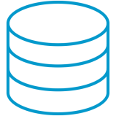

integration Platform
Services, data, partners, Messages and Files
webMethods ESB
Custom and Packaged Applications
Software As a Service (Saas)
Mainframe and Legacy Systems
B2B Partners
Databases
The foundation for a Service Oriented Architecture

Slide 8

Integration platform – capability view
DESIGN TIME
RUNTIME
Integration Server
Service Implementation and Orchestration
Administration and Monitoring
Service Infrastructure
Designer
Documents, Protocols and Transports
Custom
Applications
Rules Runtime
Process Runtime
Adapter Runtime
B2B Runtime
Messaging
Applications and Systems

Slide 9

















Key customers
Over 3800 customers
Customers in each major industry segment
Banking & Finance & Insurance
Public Services & Government
Logistics & Retail
Manufacturing
Pharmaceutical
10%
128 million
2016

Slide 10
Integration Platform – revenues
IS revenue only – does not include UM revenue
2016 numbers include ~1 mill euros of DevOps Edition/Seats (launched in June 2016) revenue
CloudsStreams revenue jumped from 760K in 2015 to 1.94 million in 2016 - up 155%

Slide 11

Design time
Service creation, orchestration, mapping, transformations
Service Development
Team size - 5

Slide 12
What is Service Orchestration?
Assembling technical services into business services
Managing the complexity of system interaction and information flow
Creating composite services to support the business
Notes:
Presentation Title
Date
Author
12

Slide 13

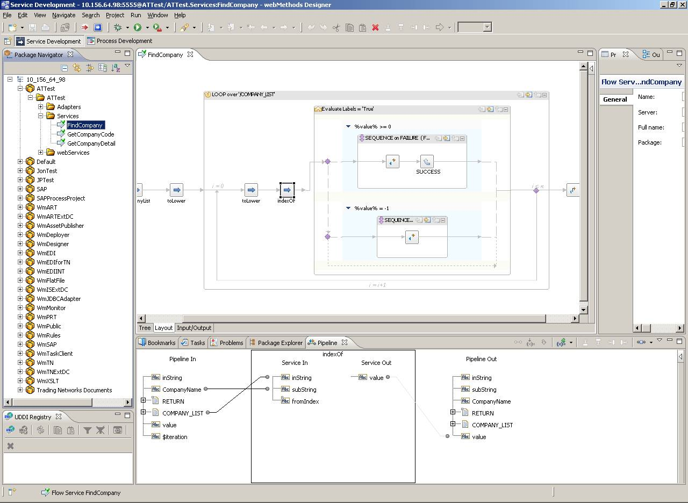
WebMethods Designer
Unified Eclipse-based development tool
Single tool for all your Integration and BPMS needs
Connected and Local development modes
Out of the box Version Control System (VCS) integration
Integrated with other webMethods and 3rd party tools to support Continuous Integration
Single eclipse-based tool
Faster development

Slide 14
designer - service development
Integrated Development Environment
Remote, Local Development modes
OOB Version Control Integration
Asset Compare and Merge
Graphical and Structured Editors
SERVICE DEVELOPMENT
Support for Continuous Integration
Version
Inter-Operability
Unit Testing Framework – part of DevOps edition
Notes:
Create, Build, Test, Debug and Publish
Services – Flow, Java, Web Services, REST, .NET
Document – Doctypes

Slide 15
service orchestration
mapping, transformation, enrichment
Parse/Transform
XML, JSON, EDI and Flat Files
Drop-in transformers
Extensive library for manipulating strings, date, math and more
User Defined Templates
Graphical mapping - any to any document formats
SERVICE ORCHESTRATION
Reuse complex mappings
Step by Step Debug
Unit Testing Framework – part of DevOps edition

Slide 16
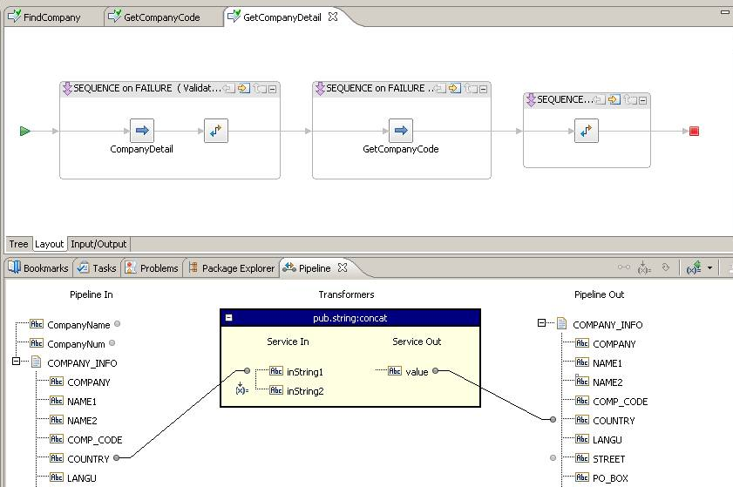
Service Orchestration
Mapping, Transformation and Enrichment
Graphical mapping between any to any document formats
Parse and transform all formats including XML, JSON, EDI and Flat Files
Drop-in transformers for in-line enrichment and Global variable support
Extensive library for manipulating strings, date, math and more
Point and Click mapping between complex formats
Quickly integrate between systems
Segment mapping enables reuse and consistency

Slide 17
Service Orchestration
Putting the Pieces Together
Unified Eclipse-based, graphical development environment
Built in services library and visual debugging to speed development
Import, define and manage complex document formats
Rapidly assemble services using FLOW
Protect existing investments in training
Faster development
Seamless integration with other webMethods suite components

Slide 18
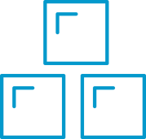

webMethods
Development and Deployment
Designer Development
Source Control
Build Scripts
File System Representation of all Assets
Unit Test Framework
Packaged Deployment
Deployment Types
Combination of product, techniques and scripts provide continuous integration
DEVELOP
BUILD / TEST
DEPLOY
File representation for assets helps in deployment
Single source of truth with tighter VCS integration
Integrated Tools
Automation Support
Greater Flexibility

Slide 19

runtime
Integration Server
Team size – 26
Team Size - 16
Adapters
Team size - 12
Integration Server and
Adapters
webMethods Integration Server
It is a Java-based, multiplatform enterprise integration server. It supports the integration of diverse services, enables mapping data between formats and communication between systems

Slide 20










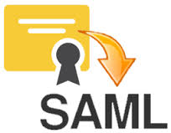


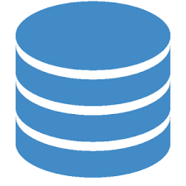







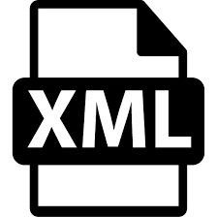











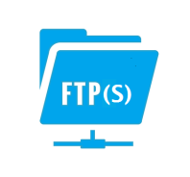

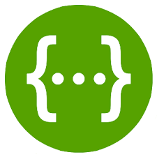




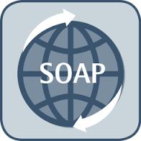
Integration Server – components view
Constructs
Integration Server
xml
generic
JMS
Map
Loop
Software AG Providers
3rd Party Providers
Pipeline
Flow
Sequence
SERVICE INFRASTRUCTURE
ForEach
Doc Types
Native
Broker
Branch
Exit
Repeat
Guaranteed Delivery
Flow Engine
NTLM
Messaging Subsystem
Connection Pool
Digest
Security
Authentication
API Gateway
Pooling
ADAPTERS
Logging
Audit
Caching
DES
Package Management
Runtime Environment
Clustering
Listeners
Service Infrastructure
Standards
Transaction Management
Session Pool
Basic
JCA, XA
Authorization
Thread Pool
Journal
WebServices
WebSockets
Scheduler
ACLs
Transports
Scheduler
- WS-RELIABLEMESSAGING
File Polling
- WS-POLICY
Lifecycle
Import/ Export
Archiving
Deployment
- WS-SECURITY
IS Package
Swagger
- WS-ADDRESSING

Slide 21
Integration Server – Deep Dive
Constructs
Integration Server
xml
generic
JMS
Map
Loop
Software AG Providers
3rd Party Providers
Pipeline
Flow
Sequence
SERVICE INFRASTRUCTURE
ForEach
Doc Types
Native
Broker
Branch
Exit
Repeat
Guaranteed Delivery
Flow Engine
NTLM
Messaging Subsystem
Connection Pool
Digest
Security
Authentication
API Gateway
Pooling
ADAPTERS
Logging
Audit
Caching
DES
Package Management
Runtime Environment
Clustering
Listeners
Service Infrastructure
Standards
Transaction Management
Session Pool
Basic
JCA, XA
Authorization
Thread Pool
Journal
WebServices
WebSockets
Scheduler
ACLs
Transports
Scheduler
- WS-RELIABLE MESSAGING
File Polling
- WS-POLICY
Lifecycle
Import/ Export
Archiving
Deployment
- WS-SECURITY
IS Package
Swagger
- WS-ADDRESSING

Slide 22











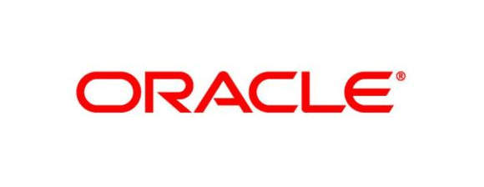

Integration server - product FLOW
Design Time
RunTime
Clients
Designer
Content Handler
Listeners
Clients Invoke Service
2. XML/JSON
Service Orchestration
ACLManager
AuditLogManager
PipelineProcessor
3. IData format
Namespace
Service Invocation
Messaging
JMS
Native
Publish/Send Messages
Broker
5. Produce
Subscribed Messages
4. Get Service from in Namespace
5. Service to outbound 3rd party
Outbound Clients
5. Outbound via Adapters
Adapters/ Connectors

Slide 23
ESB product FLOW
Design Time
RunTime
Clients
Designer
Content Handler
Listeners
Clients Invoke Service
XML/JSON
Service Orchestration
ACLManager
AuditLogManager
PipelineProcessor
3. IData format
Namespace
Service Invocation
Messaging
JMS
Native
Publish/Send Messages
Broker
Produce
Subscribed Messages
Get Service from Namespace
Service to outbound 3rd party
Outbound Clients
Outbound via Adapters
Adapters/ Connectors

Slide 24



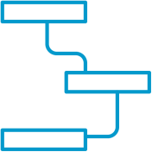
Service Invocation
Flexible Options
HTTP(S)
FTP(S)
SOAP
JMS
Scheduler
SMTP
BPM Event
Java Client
C/C++ Client
.NET Client
Adapter
FLOW
ON DEMAND
SCHEDULED
EVENT DRIVEN
webMethods Integration Server can support any Integration Pattern

Slide 25
scale

Slide 26
Integration @ Internet Scale =
webMethods + Terracotta
Distributed caching using TSA
Integration Server
On Demand
Scale out…
Integration Server
Ehcache
Ehcache
BigMemory
On Demand
Scale Up…
BigMemory
Commodity Server 1
Commodity Server…n
Custom data cache using public caching services
Scalable Integration Infrastructure
TSA Server #1
On Demand
Scale Up…
TSA Server #n
One click “Service Result Caching”
BigMemory
On Demand
Scale out…
BigMemory
Inflexible Backend Infrastructure
Support for Ehcache search API
Scale-out and Scale-Up using Terracotta TSA and BigMemory

Slide 27

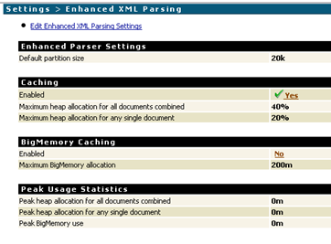
Big XML Processing
Large XML (> 1 GB) can be parsed in-memory by caching portions on Ehcache
Large XML files
Integration Server
Ehcache
BigMemory
Multiple files can be processed simultaneously
Ability to optionally use BigMemory to keep parsed portions on disk instead of Heap
Simultaneously process multiple large XML documents

Slide 28


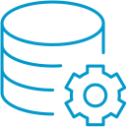




highlights
Everything in the webMethods IS is a service
Built in service libraries speeds development
ESB
Rapidly assemble using FLOW Language
Visual transformation, mapping, and routing
Library of application/technology adapters
Hide complexity of heterogeneous technologies
Point and Click mapping between formats
Seamless integration with other webMethods suite components

Slide 29
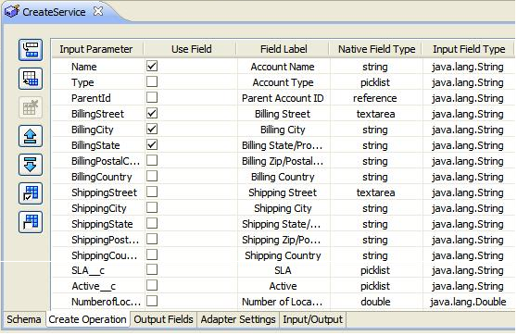
Webmethods adapters
Codeless, wizard-driven service development
Intelligent introspection of data sources
Adapter Runtime-based connection, session and transaction management
Listener and polling-based event notifications
Adapter Development Kit
Easily configured, no coding required
Rapidly enable existing investments

Slide 30
webMethods adapters
Integration Server
Service Implementation and Orchestration
Adapter Runtime
Administration and Monitoring
Connection Management
Service Framework
Listeners and Notifications
Service Infrastructure
Adapter
Adapter
Designer
Documents, Protocols and Transports
Client
Client
Custom
Applications
Rules Runtime
BPMS Runtime
Adapter Runtime
Adapter Runtime
B2B Runtime
Messaging
Applications and Systems
Applications and Systems

Slide 31






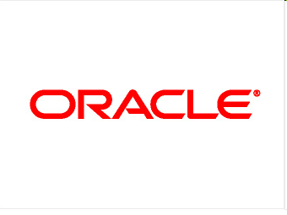










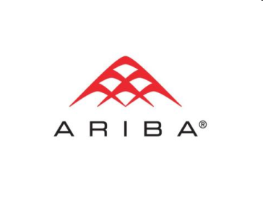
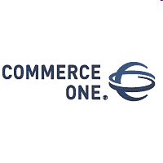
Comprehensive Application Connectivity
Technology Adapters
Application Adapters
Big Data Adapters
JDBC
Tuxedo
x.400
NoSQL
36
Adapters

Slide 32
DEMO

Slide 33
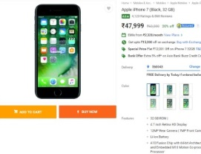
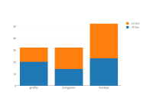
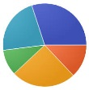
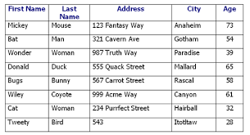
Demo USE CASE
SY Retailers - Phone Dealers
Place Order UI
ANALYTICS
New Order
Order Processing Unit
Order Info
Payment Processing
Compute Tax

Slide 34


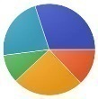



Demo SLIDE
Create Services and Connection
Create Trigger, Services and Hbase Connection
Analyze Data
Designer
New Order Placed
OrderReceivingNode
OrderProcessingNode
Oracle JDBC
Configure Polling notification
JDBC Notification
Push Order To UM
Notification from UM
JMSTrigger
Push Info to Hbase For Analytics
ADAPTERS
Compute Tax
ADAPTERS
Get the polling notification
Push Transaction Data to DB
Payment Processing
Services
Configure Connection Factory and Destination

Slide 35







challenges
ESB
Keep pace with multitude of technologies, standards and versions
Complex customer landscapes beyond the Integration layer
Setup and Testing with various backend systems
Support of conflicting system requirements of Third Party Client libraries
Support Load – Guilty until proven innocent

